Slide 1
Modul Pembelajaran [Kode Modul]
Data Manipulation with Pandas
Pathway | : | Data Science
Sub Pathway | : | Data Science
Kompetensi | :
Key Element | :
Level | : | Beginner
Developer | : | Telkom University
Approval | :
Rev. : 00
Created/Last Modified : 12-2021

Slide 2
Modul Pembelajaran | : | Data Manipulation with Pandas
Deskripsi Modul | : | Modul ini membahas tentang cara melakukan manipulasi terhadap data menggunakan pandas dan juga melakukan visualisasi data
Enabling Learning Objective | : | Peserta mengetahui cara membaca / menyimpan file, mengatasi anomali data, menampilkan data dengan filter tertentu menggunakan library pandas dan memvisualisasikan datanya
Daftar Topik | : | DataFrame Aggregating Data Slicing and Indexing Data Creating and Visualizing Data
Searching Keyword | : | DataFrame Missing Value Slicing and Indexing Groupby Subsetting Summary Statistic Pivot Table

Slide 3
Data Manipulation with Pandas

Slide 4
Modul Outline
Chapter 1 : DataFrames
Sorting and subsetting
Creating new columns
Chapter 2: Aggregating Data
Summary statistics
Counting
Grouped summary statistics
Chapter 3 : Slicing and Indexing Data
Subsetting using slicing
Indexes and subsetting using indexes
Chapter 4 : Creating and Visualizing Data
Plotting
Handling missing data
Reading data into a DataFrame

Slide 5
Module Objectives
Able to implement pandas to manipulate the DataFrames
Able to import, clean, calculate statistics, and create visualization

Slide 6
Introducing DataFrames
DATA M A N I P U L AT I O N W I T H PA N DA S

Slide 7
What's the point of pandas?
Data Manipulation skill track Data Visualization skill track
Notes:
pandas is a Python package for data manipulation. It can also be used for data visualization; we'll get to that in Chapter 4.

Slide 8
Course outline
Chapter 1: DataFrames Sorting and subseting
Creating new columns Chapter 2: Aggregating Data
Summary statistics
Counting
Grouped summary statistics
Chapter 3: Slicing and Indexing Data Subseting using slicing
Indexes and subseting using indexes Chapter 4: Creating and Visualizing Data
Ploting
Handling missing data
Reading data into a DataFrame
Notes:
We'll start by talking about DataFrames, which form the core of pandas. In chapter 2, we'll discuss aggregating data to gather insights. In chapter 3, you'll learn all about slicing and indexing to subset DataFrames. Finally, you'll visualize your data, deal with missing data, and read data into a DataFrame. Let's dive in.

Slide 9

pandas is built on NumPy and Matplotlib
Notes:
pandas is built on top of two essential Python packages, NumPy and Matplotlib. Numpy provides multidimensional array objects for easy data manipulation that pandas uses to store data, and Matplotlib has powerful data visualization capabilities that pandas takes advantage of.

Slide 10

pandas is popular
¹ htps://pypistats.org/packages/pandas
Notes:
pandas has millions of users, with PyPi recording about 14 million downloads in December 2019. This represents almost the entire Python data science community!

Slide 11
Rectangular data
Name | Breed | Color | Height (cm) | Weight (kg) | Date of Birth
Bella | Labrador | Brown | 56 | 25 | 2013-07-01
Charlie | Poodle | Black | 43 | 23 | 2016-09-16
Lucy | Chow Chow | Brown | 46 | 22 | 2014-08-25
Cooper | Schnauzer | Gray | 49 | 17 | 2011-12-11
Max | Labrador | Black | 59 | 29 | 2017-01-20
Stella | Chihuahua | Tan | 18 | 2 | 2015-04-20
Bernie | St. Bernard | White | 77 | 74 | 2018-02-27
Notes:
There are several ways to store data for analysis, but rectangular data, sometimes called "tabular data" is the most common form. In this example, with dogs, each observation, or each dog, is a row, and each variable, or each dog property, is a column. pandas is designed to work with rectangular data like this.

Slide 12
pandas DataFrames
print(dogs)
name | breed | color | height_cm | weight_kg | date_of_birth
0 Bella | Labrador | Brown | 56 | 24 | 2013-07-01
1 Charlie | Poodle | Black | 43 | 24 | 2016-09-16
2 Lucy | Chow Chow | Brown | 46 | 24 | 2014-08-25
3 Cooper | Schnauzer | Gray | 49 | 17 | 2011-12-11
4 Max | Labrador | Black | 59 | 29 | 2017-01-20
5 Stella | Chihuahua | Tan | 18 | 2 | 2015-04-20
6 Bernie | St. Bernard | White | 77 | 74 | 2018-02-27
Notes:
In pandas, rectangular data is represented as a DataFrame object. Every programming language used for data analysis has something similar to this. R also has DataFrames, while SQL has database tables. Every value within a column has the same data type, either text or numeric, but different columns can contain different data types.

Slide 13
Exploring a DataFrame: .head()
dogs.head()
name | breed | color | height_cm | weight_kg | date_of_birth
0 Bella | Labrador | Brown | 56 | 24 | 2013-07-01
1 Charlie | Poodle | Black | 43 | 24 | 2016-09-16
2 Lucy | Chow Chow | Brown | 46 | 24 | 2014-08-25
3 Cooper | Schnauzer | Gray | 49 | 17 | 2011-12-11
4 Max | Labrador | Black | 59 | 29 | 2017-01-20
Notes:
When you first receive a new dataset, you want to quickly explore it and get a sense of its contents. pandas has several methods for this. The first is head, which returns the first few rows of the DataFrame. We only had seven rows to begin with, so it's not super exciting, but this becomes very useful if you have many rows.

Slide 14
Exploring a DataFrame: .info()
dogs.info()
<class 'pandas.core.frame.DataFrame'> RangeIndex: 7 entries, 0 to 6
Data # | columns Column | (total | 6 columns): Non-Null Count |  | Dtype
0 | name |  | 7 | non-null | object
1 | breed |  | 7 | non-null | object
2 | color |  | 7 | non-null | object
3 | height_cm |  | 7 | non-null | int64
4 | weight_kg |  | 7 | non-null | int64
5 | date_of_birth |  | 7 | non-null | object
dtypes: int64(2), object(4) memory usage: 464.0+ bytes
Notes:
The info method displays the names of columns, the data types they contain, and whether they have any missing values.

Slide 15
Exploring a DataFrame: .shape
dogs.shape
(7, 6)
Notes:
A DataFrame's shape attribute contains a tuple that holds the number of rows followed by the number of columns. Since this is an attribute instead of a method, you write it without parentheses.

Slide 16
Exploring a DataFrame: .describe()
dogs.describe()
 | height_cm | weight_kg
count | 7.000000 | 7.000000
mean | 49.714286 | 27.428571
std | 17.960274 | 22.292429
min | 18.000000 | 2.000000
25% | 44.500000 | 19.500000
50% | 49.000000 | 23.000000
75% | 57.500000 | 27.000000
max | 77.000000 | 74.000000
Notes:
The describe method computes some summary statistics for numerical columns, like mean and median. "count" is the number of non-missing values in each column. describe is good for a quick overview of numeric variables, but if you want more control, you'll see how to perform more specific calculations later in the course.

Slide 17
Components of a DataFrame: .values
dogs.values
array([['Bella', 'Labrador', 'Brown', 56, 24, '2013-07-01'],
['Charlie', 'Poodle', 'Black', 43, 24, '2016-09-16'],
['Lucy', 'Chow Chow', 'Brown', 46, 24, '2014-08-25'],
['Cooper', 'Schnauzer', 'Gray', 49, 17, '2011-12-11'],
['Max', 'Labrador', 'Black', 59, 29, '2017-01-20'],
['Stella', 'Chihuahua', 'Tan', 18, 2, '2015-04-20'],
['Bernie', 'St. Bernard', 'White', 77, 74, '2018-02-27']], dtype=object)
Notes:
DataFrames consist of three different components, accessible using attributes. The values attribute, as you might expect, contains the data values in a 2-dimensional NumPy array.

Slide 18
Components of a DataFrame: .columns and .index
dogs.columns
Index(['name', 'breed', 'color', 'height_cm', 'weight_kg', 'date_of_birth'], dtype='object')
dogs.index
RangeIndex(start=0, stop=7, step=1)
Notes:
The other two components of a DataFrame are labels for columns and rows. The columns attribute contains column names, and the index attribute contains row numbers or row names. Be careful, since row labels are stored in dot-index, not in dot-rows. Notice that these are Index objects, which we'll cover in Chapter 3. This allows for flexibility in labels. For example, the dogs data uses row numbers, but row names are also possible.

Slide 19

pandas Philosophy
There should be one -- and preferably only one -- obvious way to do it.
- The Zen of Python by Tim Peters, Item 13
¹ htps://www.python.org/dev/peps/pep-0020/
Notes:
Python has a semi-official philosophy on how to write good code called The Zen of Python. One suggestion is that given a programming problem, there should only be one obvious solution. As you go through this course, bear in mind that pandas deliberately doesn't follow this philosophy. Instead, there are often multiple ways to solve a problem, leaving you to choose the best. In this respect, pandas is like a Swiss Army Knife, giving you a variety of tools, making it incredibly powerful, but more difficult to learn. In this course, we aim for a more streamlined approach to pandas, only covering the most important ways of doing things.

Slide 20
Sorting and subsetting
DATA M A N I P U L AT I O N W I T H PA N DA S

Slide 21
Sorting
dogs.sort_values("weight_kg")
name
5 Stella
3 Cooper
Bella
Charlie
Lucy
4 Max
6 Bernie
breed Chihuahua Schnauzer Labrador Poodle Chow Chow Labrador
St. Bernard
color height_cm Tan 18
Gray 49
Brown 56
Black 43
Brown 46
Black 59
White 77
weight_kg date_of_birth
2
17
24
24
24
29
74
2015-04-20
2011-12-11
2013-07-01
2016-09-16
2014-08-25
2017-01-20
2018-02-27
Notes:
The first thing you can do is change the order of the rows by sorting them so that the most interesting data is at the top of the DataFrame. You can sort rows using the sort_values method, passing in a column name that you want to sort by. For example, when we apply sort_values on the weight_kg column of the dogs DataFrame, we get the lightest dog at the top, Stella the Chihuahua, and the heaviest dog at the bottom, Bernie the Saint Bernard.

Slide 22
Sorting in descending order
dogs.sort_values("weight_kg", ascending=False)
 | name |  | breed | color | height_cm | weight_kg | date_of_birth
6 | Bernie | St. | Bernard | White | 77 | 74 | 2018-02-27
4 | Max | Labrador |  | Black | 59 | 29 | 2017-01-20
0 | Bella | Labrador |  | Brown | 56 | 24 | 2013-07-01
1 | Charlie | Poodle |  | Black | 43 | 24 | 2016-09-16
2 | Lucy | Chow Chow |  | Brown | 46 | 24 | 2014-08-25
3 | Cooper | Schnauzer |  | Gray | 49 | 17 | 2011-12-11
5 | Stella | Chihuahua |  | Tan | 18 | 2 | 2015-04-20
Notes:
Setting the ascending argument to False will sort the data the other way around, from heaviest dog to lightest dog.

Slide 23
Sorting by multiple variables
dogs.sort_values(["weight_kg", "height_cm"])
name
5 Stella
3 Cooper
Charlie
Lucy
0 Bella
4 Max
6 Bernie
breed Chihuahua Schnauzer
Poodle Chow Chow Labrador Labrador St. Bernard
color height_cm Tan 18
Gray 49
Black 43
Brown 46
Brown 56
Black 59
White 77
weight_kg date_of_birth
2
17
24
24
24
29
74
2015-04-20
2011-12-11
2016-09-16
2014-08-25
2013-07-01
2017-01-20
2018-02-27
Notes:
We can sort by multiple variables by passing a list of column names to sort_values. Here, we sort first by weight, then by height. Now, Charlie, Lucy, and Bella are ordered from shortest to tallest, even though they all weigh the same.

Slide 24
Sorting by multiple variables
dogs.sort_values(["weight_kg", "height_cm"], ascending=[True, False])
name
5 Stella
3 Cooper
0 Bella
2 Lucy
1 Charlie
4 Max
6 Bernie
breed Chihuahua Schnauzer Labrador Chow Chow
Poodle Labrador St. Bernard
color height_cm Tan 18
Gray 49
Brown 56
Brown 46
Black 43
Black 59
White 77
weight_kg date_of_birth
2
17
24
24
24
29
74
2015-04-20
2011-12-11
2013-07-01
2014-08-25
2016-09-16
2017-01-20
2018-02-27
Notes:
To change the direction values are sorted in, pass a list to the ascending argument to specify which direction sorting should be done for each variable. Now, Charlie, Lucy, and Bella are ordered from tallest to shortest.

Slide 25
Subsetting columns
dogs["name"]
0 | Bella
1 | Charlie
2 | Lucy
3 | Cooper
4 | Max
5 | Stella
6 | Bernie
Name: | name, | dtype: | object
Notes:
We may want to zoom in on just one column. We can do this using the name of the DataFrame, followed by square brackets with a column name inside. Here, we can look at just the name column.

Slide 26
Subsetting multiple columns
dogs[["breed", "height_cm"]]
cols_to_subset = ["breed", "height_cm"] dogs[cols_to_subset]
breed height_cm
Labrador 56
Poodle 43
Chow Chow 46
Schnauzer 49
Labrador 59
Chihuahua 18
St. Bernard 77
breed height_cm
Labrador 56
Poodle 43
Chow Chow 46
Schnauzer 49
Labrador 59
Chihuahua 18
St. Bernard 77
Notes:
To select multiple columns, you need two pairs of square brackets. In this code, the inner and outer square brackets are performing different tasks. The outer square brackets are responsible for subsetting the DataFrame, and the inner square brackets are creating a list of column names to subset. This means you could provide a separate list of column names as a variable and then use that list to perform the same subsetting. Usually, it's easier to do in one line.

Slide 27
Subsetting rows
dogs["height_cm"] > 50
0 | True
1 | False
2 | False
3 | False
4 | True
5 | False
6 | True
Name: | height_cm, | dtype: | bool
Notes:
There are lots of different ways to subset rows. The most common way to do this is by creating a logical condition to filter against. For example, let's find all the dogs whose height is greater than 50 centimeters. Now we have a True or False value for every row.

Slide 28
Subsetting rows
dogs[dogs["height_cm"] > 50]
 | name | breed | color | height_cm | weight_kg | date_of_birth
0 | Bella | Labrador | Brown | 56 | 24 | 2013-07-01
4 | Max | Labrador | Black | 59 | 29 | 2017-01-20
6 | Bernie | St. Bernard | White | 77 | 74 | 2018-02-27
Notes:
We can use the logical condition inside of square brackets to subset the rows we're interested in to get all of the dogs taller than 50 centimeters.

Slide 29
Subsetting based on text data
dogs[dogs["breed"] == "Labrador"]
 | name | breed | color | height_cm | weight_kg | date_of_birth
0 | Bella | Labrador | Brown | 56 | 24 | 2013-07-01
4 | Max | Labrador | Black | 59 | 29 | 2017-01-20
Notes:
We can also subset rows based on text data. Here, we use the double equal sign in the logical condition to filter the dogs that are Labradors.

Slide 30
Subsetting based on dates
dogs[dogs["date_of_birth"] < "2015-01-01"]
name
0 Bella
Lucy
Cooper
breed Labrador Chow Chow Schnauzer
color height_cm Brown 56
Brown 46
Gray 49
weight_kg date_of_birth
24
24
17
2013-07-01
2014-08-25
2011-12-11
Notes:
We can also subset based on dates. Here, we filter all the dogs born before 2015. Notice that the dates are in quotes and are written as year then month, then day. This is the international standard date format.

Slide 31
Subsetting based on multiple conditions
is_lab = dogs["breed"] == "Labrador" is_brown = dogs["color"] == "Brown" dogs[is_lab & is_brown]
 | name | breed | color | height_cm | weight_kg | date_of_birth
0 | Bella | Labrador | Brown | 56 | 24 | 2013-07-01
dogs[ (dogs["breed"] == "Labrador") & (dogs["color"] == "Brown") ]
Notes:
To subset the rows that meet multiple conditions, you can combine conditions using logical operators, such as the "and" operator seen here. This means that only rows that meet both of these conditions will be subsetted. You could also do this in one line of code, but you'll also need to add parentheses around each condition.

Slide 32
Subsetting using .isin()
is_black_or_brown = dogs["color"].isin(["Black", "Brown"]) dogs[is_black_or_brown]
name | breed | color | height_cm | weight_kg | date_of_birth
0 Bella | Labrador | Brown | 56 | 24 | 2013-07-01
1 Charlie | Poodle | Black | 43 | 24 | 2016-09-16
2 Lucy | Chow Chow | Brown | 46 | 24 | 2014-08-25
4 Max | Labrador | Black | 59 | 29 | 2017-01-20
Notes:
If you want to filter on multiple values of a categorical variable, the easiest way is to use the isin method. This takes in a list of values to filter for. Here, we check if the color of a dog is black or brown, and use this condition to subset the data.

Slide 33
New Columns

Slide 34
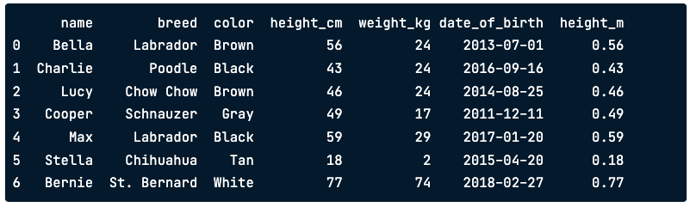
Adding new column
# Add new column height_m obtained from height_cm divided by 100
dataframe[“height_m”] = dataframe[“height_cm”] / 100
print(dataframe)
Notes:
Creating and adding new columns can go by many names, including mutating a DataFrame, transforming a DataFrame, and feature engineering. Let's say we want to add a new column to our DataFrame that has each dog's height in meters instead of centimeters. On the left-hand side of the equals, we use square brackets with the name of the new column we want to create. On the right-hand side, we have the calculation. Notice that both the existing column and the new column we just created are in the DataFrame.

Slide 35
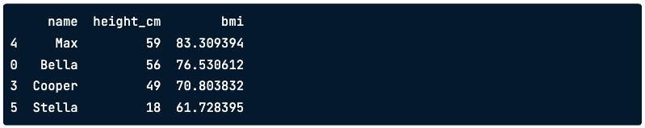
Multiple manipulations
bmi_lt_100 = dataframe[dataframe["bmi"] < 100]
bmi_lt_100_height = bmi_lt_100.sort_values("height_cm", ascending = False)
bmi_lt_100_height[["name”, "height_cm", "bmi"]]
Notes:
The real power of pandas comes in when you combine all the skills you've learned so far. Let's figure out the names of skinny, tall dogs. First, to define the skinny dogs, we take the subset of the dogs who have a BMI of under 100. Next, we sort the result in descending order of height to get the tallest skinny dogs at the top. Finally, we keep only the columns we're interested in. Here, you can see that Max is the tallest dog with a BMI of under 100.

Slide 36
Chapter 2 : Agregating DataFrames

Slide 37
Summary Statistic

Slide 38

Summarizing Numerical Data
dataframe[”height_cm"].mean()
.median(), mode()
.min(), .max()
.var(), .std()
.sum
.quantile()
Notes:
One of the most common summary statistics for numeric data is the mean, which is one way of telling you where the "center" of your data is. You can calculate the mean of a column by selecting the column with square brackets and calling dot-mean. There are lots of other summary statistics that you can compute on columns, like median and mode, minimum and maximum, and variance and standard deviation. You can also take sums and calculate quantiles.

Slide 39
The .agg() method
def pct30(column):
return column.quantile(0.3)
dataframe["weight_kg"].agg(pct30)
Notes:
The aggregate, or agg, method allows you to compute custom summary statistics. Here, we create a function called pct30 that computes the thirtieth percentile of a DataFrame column. Don't worry if this code doesn't make sense to you -- just know that the function takes in a column and spits out the column's thirtieth percentile. Now we can subset the weight column and call dot-agg, passing in the name of our function, pct30. It gives us the thirtieth percentile of the dogs' weights.

Slide 40
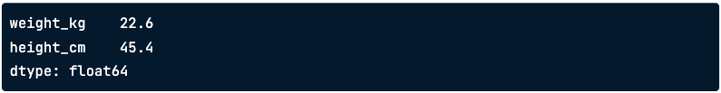
Summaries on multiple columns
dataframe[["weight_kg”,”height_cm”]].agg(pct30)
Notes:
agg can also be used on more than one column. By selecting the weight and height columns before calling agg, we get the thirtieth percentile for both columns.

Slide 41
Cumulative Statistics
.cummax()
.cumming()
.cumprod()
Notes:
pandas also has methods for other cumulative statistics, such as the cumulative maximum, cumulative minimum, and the cumulative product. These all return an entire column of a DataFrame, rather than a single number.

Slide 42
Counting

Slide 43
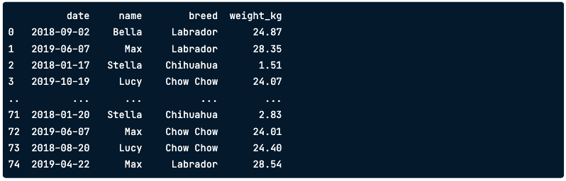
Vet Visits
print(vet_visits)
Notes:
Here's a DataFrame that contains vet visits. The vet's office wants to know how many dogs of each breed have visited their office. However, some dogs have been to the vet more than once, like Max and Stella, so we can't just count the number of each breed in the breed column.

Slide 44
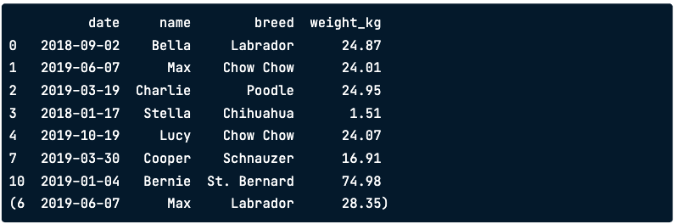
Dropping duplicate names
vet_visits.drop_duplicates(subset="name")
Notes:
Let's try to fix this by removing rows that contain a dog name already listed earlier in the dataset, or in other words; we'll extract a dog with each name from the dataset once. We can do this using the drop_duplicates method. It takes an argument, subset, which is the column we want to find our duplicates based on - in this case, we want all the unique names. Now we have a list of dogs where each one appears once. We have Max the Chow Chow, but where did Max the Labrador go? Because we have two different dogs with the same name, we'll need to consider more than just name when dropping duplicates.

Slide 45
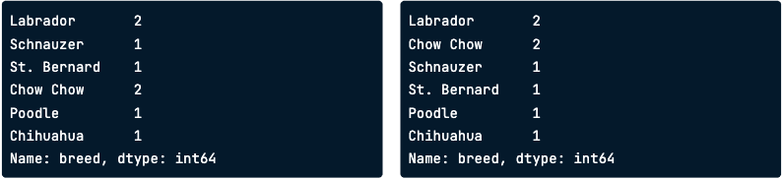
Value Counts
unique_df["breed"].value_counts()
unique_df["breed"].value_counts(sort=True)

Slide 46
Groupped Summary Statistics

Slide 47
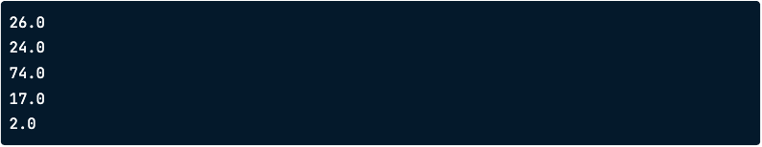
Summaries by group
dataframe[dataframe["color"] == "Black"]["weight_kg"].mean()
dataframe[dataframe["color"] == "Brown"]["weight_kg"].mean()
dataframe[dataframe["color"] == "White"]["weight_kg"].mean()
dataframe[dataframe["color"] == "Gray"]["weight_kg"].mean()
dataframe[dataframe["color"] == "Tan"]["weight_kg"].mean()
Notes:
While computing summary statistics of entire columns may be useful, you can gain many insights from summaries of individual groups. For example, does one color of dog weigh more than another on average? Are female dogs taller than males? You can already answer these questions with what you've learned so far! We can subset the dogs into groups based on their color, and take the mean of each. But that's a lot of work, and the duplicated code means you can easily introduce copy and paste bugs.

Slide 48
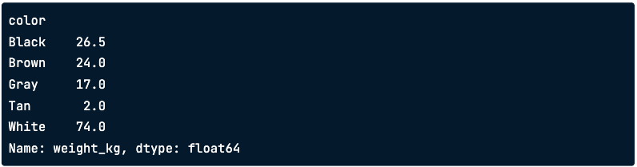
Grouped Summaries
dataframe.groupby("color")["weight_kg"].mean()
Notes:
That's where the groupby method comes in. We can group by the color variable, select the weight column, and take the mean. This will give us the mean weight for each dog color. This was just one line of code compared to the five we had to write before to get the same results.

Slide 49
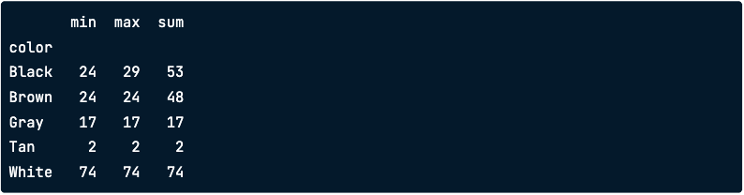
Multiple Grouped Summaries
dataframe.groupby("color")["weight_kg"].agg([min, max, sum])
Notes:
Just like with ungrouped summary statistics, we can use the agg method to get multiple statistics. Here, we pass a list of functions into agg after grouping by color. This gives us the minimum, maximum, and sum of the different colored dogs' weights.

Slide 50
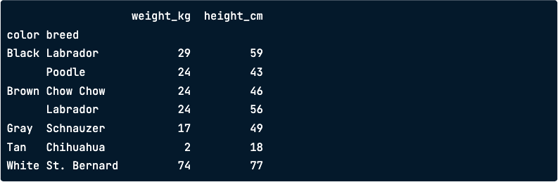
Multiple Grouped Summaries
dataframe.groupby(["color", "breed"])[["weight_kg", "height_cm"]].mean()
Notes:
You can also group by multiple columns and calculate summary statistics. Here, we group by color and breed, select the weight column and take the mean. This gives us the mean weight of each breed of each color.

Slide 51
Pivot Tables

Slide 52
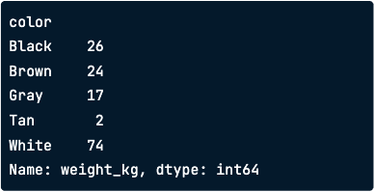
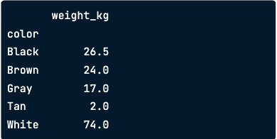
Group by to pivot table
dataframe.groupby("color")[
"weight_kg"].mean()
dataframe.pivot_table(
values=“weight_kg”, index=“color”)
Notes:
In the last lesson, we grouped the dogs by color and calculated their mean weights. We can do the same thing using the pivot_table method. The "values" argument is the column that you want to summarize, and the index column is the column that you want to group by. By default, pivot_table takes the mean value for each group.

Slide 53
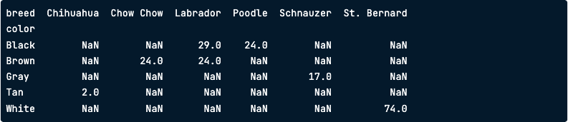
Pivot on two variables
dataframe.groupby(["color”,”breed"])[”weight_kg].mean()
dataframe.pivot_table(values=“weight_kg”, index=“color”, columns=”breed”)
Notes:
You also previously computed the mean weight grouped by two variables: color and breed. We can also do this using the pivot_table method. To group by two variables, we can pass a second variable name into the columns argument. While the result looks a little different than what we had before, it contains the same numbers. There are NaNs, or missing values, because there are no black Chihuahuas or gray Labradors in our dataset, for example.

Slide 54
Filling missing values in pivot tables
dataframe.pivot_table(values=“weight_kg”, index=“color”, columns=”breed”, fill_value=0 )
Notes:
Instead of having lots of missing values in our pivot table, we can have them filled in using the fill_value argument. Here, all of the NaNs get filled in with zeros.

Slide 55
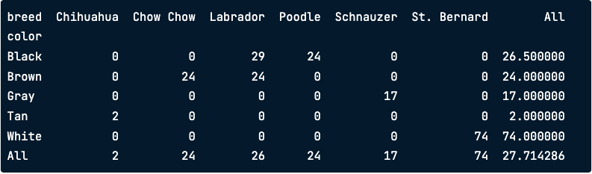
Summing with pivot
dataframe.pivot_table(values=“weight_kg”, index=“color”, columns=”breed”,
fill_value=0, margin=True)
Notes:
If we set the margins argument to True, the last row and last column of the pivot table contain the mean of all the values in the column or row, not including the missing values that were filled in with Os. For example, in the last row of the Labrador column, we can see that the mean weight of the Labradors is 26 kilograms. In the last column of the Brown row, the mean weight of the Brown dogs is 24 kilograms. The value in the bottom right, in the last row and last column, is the mean weight of all the dogs in the dataset. Using margins equals True allows us to see a summary statistic for multiple levels of the dataset: the entire dataset, grouped by one variable, by another variable, and by two variables.

Slide 56
Chapter 3 : Slicing and Indexing DataFrames

Slide 57
Explicit Indexes

Slide 58
Setting a column as the index
dataframe_ind = dataframe.set_index(“name”)
print(dataframe_ind)
Notes:
You can move a column from the body of the DataFrame to the index. This is called "setting an index," and it uses the set_index method. Notice that the output has changed slightly; in particular, a quick visual clue that name is now in the index is that the index values are left-aligned rather than right-aligned.

Slide 59
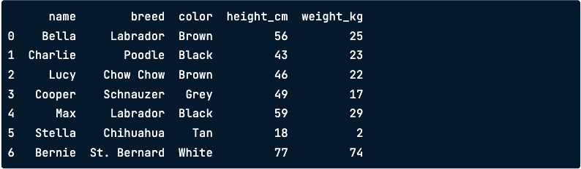
Removing an index
dataframe_ind.reset_index()
Notes:
To undo what you just did, you can reset the index - that is, you remove it. This is done via reset_index.

Slide 60
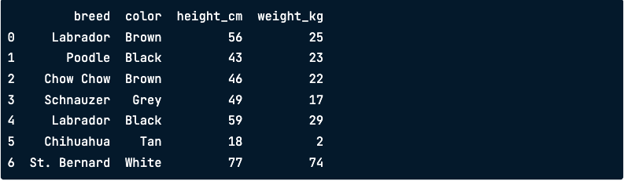
Dropping an index
dataframe_ind.reset_index(drop = True)
Notes:
reset_index has a drop argument that allows you to discard an index. Here, setting drop to True entirely removes the dog names.

Slide 61
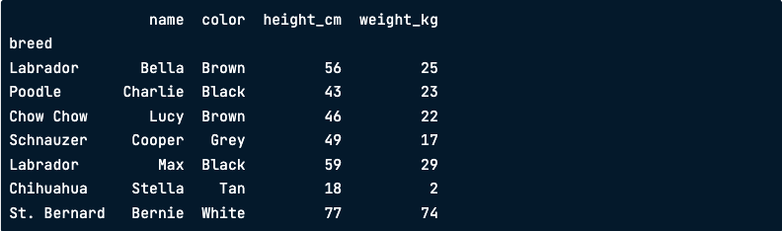
Index value don’t need to be unique
dataframe_ind2 = dataframe.set_index(“breed”)
print(dataframe_ind2)
Notes:
The values in the index don't need to be unique. Here, there are two Labradors in the index.

Slide 62
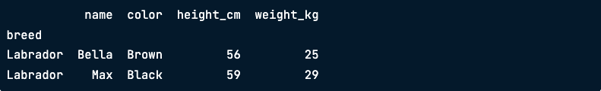
Subsetting on duplicated index values
dataframe_ind2.loc[”Labrador”]
Notes:
Now, if you subset on "Labrador" using loc, all the Labrador data is returned.

Slide 63
Slicing and Subsetting with .loc and .iloc

Slide 64

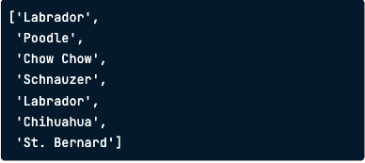

Slicing lists
breeds = ["Labrador", "Poodle",
"Chow Chow", "Schnauzer",
"Labrador", "Chihuahua", "St. Bernard"]
Breeds[2:5]
Breeds[:3]
Breeds[:]
Notes:
Here are the dog breeds, this time as a list. To slice the list, you pass first and last positions separated by a colon into square brackets. Remember that Python positions start from zero, so 2 refers to the third element, Chow Chow. Also remember that the last position, 5, is not included in the slice, so we finish at Labrador, not Chihuahua. If you want the slice to start from the beginning of the list, you can omit the zero. Here, using colon-3 returns the first three elements. Slicing with colon on its own returns the whole list.

Slide 65
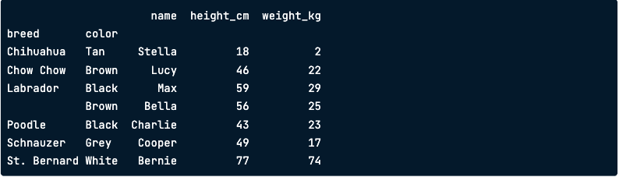
Slicing lists
dataframe_srt = dataframe.set_index([“breed”,”color”]).sort_index()
print(dataframe_srt)

Slide 66
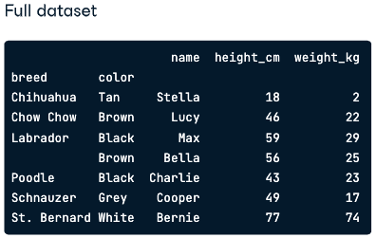
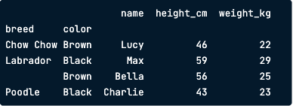
Slicing the outer index level
dataframe_srt.loc[“Chow Chow”:”Poodle”]
The final value “Poodle” is included
Notes:
To slice rows at the outer level of an index, you call loc, passing the first and last values separated by a colon. The full dataset is shown on the right for comparison. There are two differences compared to slicing lists. Rather than specifying row numbers, you specify index values. Secondly, notice that the final value is included. Here, Poodle is included in the results.

Slide 67
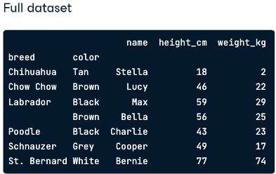

Slicing the inner index levels badly
dataframe_srt.loc[“Tan”:”Grey”]
Notes:
The same technique doesn't work on inner index levels. Here, trying to slice from Tan to Grey returns an empty DataFrame instead of the six dogs we wanted. It's important to understand the danger here. pandas doesn't throw an error to let you know that there is a problem, so be careful when coding.

Slide 68
Slicing the inner index levels correctly
dataframe_srt.loc[
(“Labrador”:”Brown”):(“Schnauzer””Grey”)]
Notes:
The correct approach to slicing at inner index levels is to pass the first and last positions as tuples. Here, the first element to include is a tuple of Labrador and Brown.

Slide 69
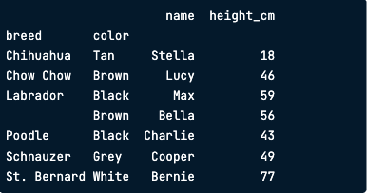
Slicing columns
dataframe_srt.loc[: , “name” : “height_cm”]
Notes:
Since DataFrames are two-dimensional objects, you can also slice columns. You do this by passing two arguments to loc. The simplest case involves subsetting columns but keeping all rows. To do this, pass a colon as the first argument to loc. As with slicing lists, a colon by itself means "keep everything." The second argument takes column names as the first and last positions to slice on.

Slide 70
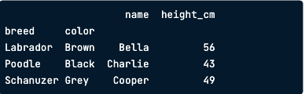
Slice twice
dataframe_srt.loc[
(“Labrador”:”Brown”):(“Schnauzer””Grey”), “name”: “height_cm”]
Notes:
You can slice on rows and columns at the same time: simply pass the appropriate slice to each argument. Here, you see the previous two slices being performed in the same line of code.

Slide 71
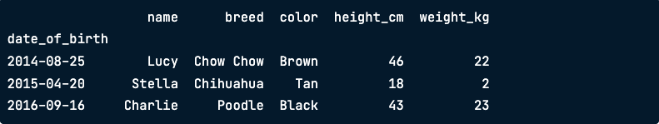
Slice by dates
# Get dataframe with date_of_birth between 2014-08-25 and 2016-09-16
dataframe.loc["2014-08-25":"2016-09-16"]
Notes:
You slice dates with the same syntax as other types. The first and last dates are passed as strings.

Slide 72
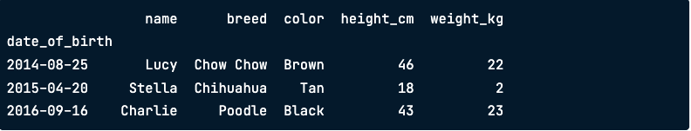
Slice by partial dates
# Get dataframe with date_of_birth between 2014-01-01 and 2016-12-31
dataframe.loc["2014":"2016"]
Notes:
One helpful feature is that you can slice by partial dates. Here, the first and last positions are only specified as 2014 and 2016, with no month or day parts. pandas interprets this as slicing from the start of 2014 to the end of 2016; that is, all dates in 2014, 2015, and 2016.

Slide 73

Subsetting by row/column number
print(dataframe.iloc[2:5 , 1:4])
Notes:
You can also slice DataFrames by row or column number using the iloc method. This uses a similar syntax to slicing lists, except that there are two arguments: one for rows and one for columns. Notice that, like list slicing but unlike loc, the final values aren't included in the slice. In this case, the fifth row and fourth column aren't included.

Slide 74
Working with Pivot Tables
Notes:
You saw how to create pivot tables with pandas in chapter two. In this lesson, you'll perform subsetting and calculations on pivot tables.

Slide 75
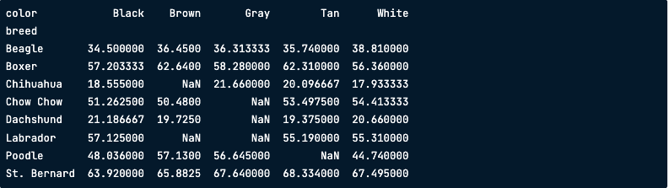
Pivotting the dataframe pack
dataframe_height_by_breed_vs_color = dataframe_pack.pivot_table(
"height_cm", index="breed", columns="color")
print(dogs_height_by_breed_vs_color)
Notes:
Recall that you create a pivot table by calling dot-pivot_table. The first argument is the column name containing values to aggregate. The index argument lists the columns to group by and display in rows, and the columns argument lists the columns to group by and display in columns. We'll use the default aggregation function, which is mean.

Slide 76
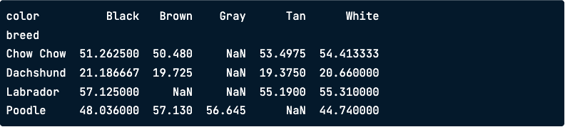
.loc[] + slicing is a power combo
dataframe_height_by_breed_vs_color.loc["Chow Chow":"Poodle"]
Notes:
Pivot tables are just DataFrames with sorted indexes. That means that all the fun stuff you've learned so far this chapter can be used on them. In particular, the loc and slicing combination is ideal for subsetting pivot tables, like so.

Slide 77
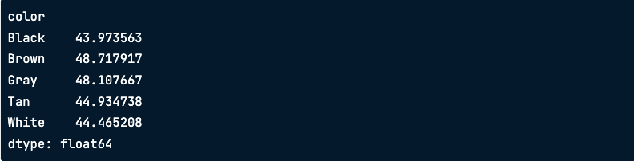
The axis argument
dataframe_height_by_breed_vs_color.mean(axis="index")
Notes:
The methods for calculating summary statistics on a DataFrame, such as mean, have an axis argument. The default value is "index," which means "calculate the statistic across rows." Here, the mean is calculated for each color. That is, "across the breeds." The behavior is the same as if you hadn't specified the axis argument.

Slide 78
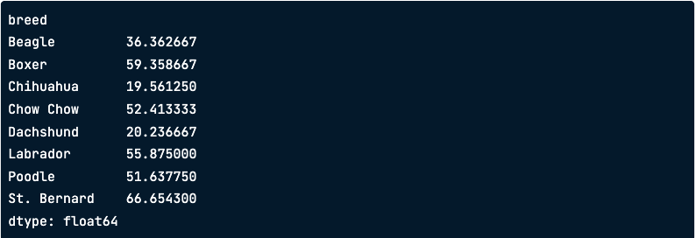
Calculating summary stats across column
dataframe_height_by_breed_vs_color.mean(axis=”columns")
Notes:
To calculate a summary statistic for each row, that is, "across the columns," you set axis to "columns." Here, the mean height is calculated for each breed. That is, "across the colors." For most DataFrames, setting the axis argument doesn't make any sense, since you'll have different data types in each column. Pivot tables are a special case since every column contains the same data type.

Slide 79
Chapter 4 : Creating and Visualizing Dataframes

Slide 80
Visualizing your data

Slide 81
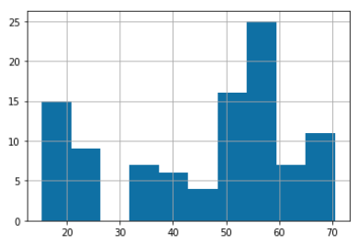
Histograms
import matplotlib.pyplot as plt
dog_pack["height_cm"].hist()
plt.show()
Notes:
Remember when we talked about matplotlib at the beginning of the course? We'll need to import matplotlib-dot-pyplot as plt in order to display our visualizations. Just like pd is the standard alias for pandas, plt is the standard alias for matplotlib-dot-pyplot. Let's create a histogram, which shows the distribution of a numeric variable. We can create a histogram of the height variable by selecting the column and calling dot-hist. In order to show the plot, we need to call plt-dot-show. The x-axis represents the heights of the dogs, and the y-axis represents the number of dogs in each height range. By grouping observations into ranges, the histogram allows us to see that there are a lot of dogs around 50 to 60 centimeters tall.

Slide 82
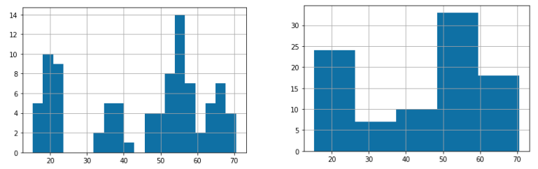
Histograms
dog_pack["height_cm"].hist(bins=20)
plt.show()
dog_pack["height_cm"].hist(bins=5)
plt.show()
Notes:
We can adjust the number of bars, or bins, using the "bins" argument. Increasing or decreasing this can give us a better idea of what the distribution looks like.

Slide 83
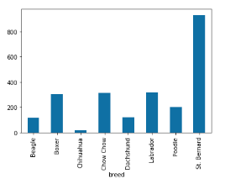
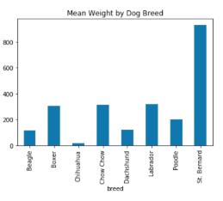
Bar plots
avg_weight_by_breed.plot(kind="bar",
title="Mean Weight by Dog Breed")
plt.show()
avg_weight_by_breed.plot(kind="bar")
plt.show()
Notes:
Bar plots can reveal relationships between a categorical variable and a numeric variable, like breed and weight. To compute the average weight of each breed, we group by breed, select the weight column, and take the mean, giving us the average weight of each breed.

Slide 84
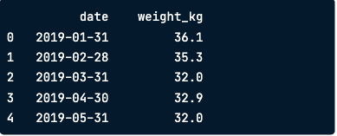
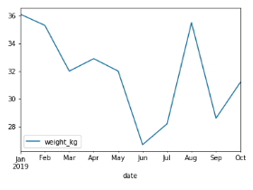
Line plots
sully.head()
sully.plot(x="date",
y="weight_kg",
kind="line")
plt.show()
Notes:
Line plots are great for visualizing changes in numeric variables over time. Lucky for us, a Labrador named Sully has been weighed by his owner every month - let's see how his weight has changed over the year. We can use the plot method again, but this time, we pass in three arguments: date as x, weight as y, and "kind" equals "line." Sully's weight has fluctuated quite a bit over the year!

Slide 85
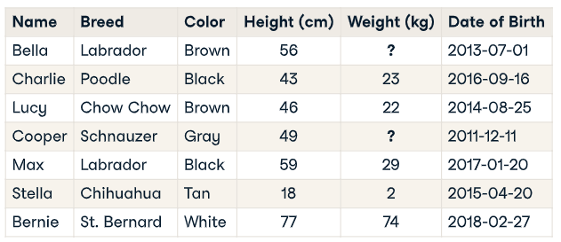
What’s missing value?
Notes:
Most data is not perfect - there's always a possibility that there are some pieces missing from your dataset. For example, maybe on the day that Bella and Cooper's owner weighed them,

Slide 86
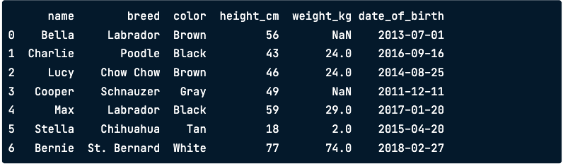
Missing values in pandas DataFrames
print(dataframe)
Notes:
In a pandas DataFrame, missing values are indicated with N-a-N, which stands for "not a number."

Slide 87
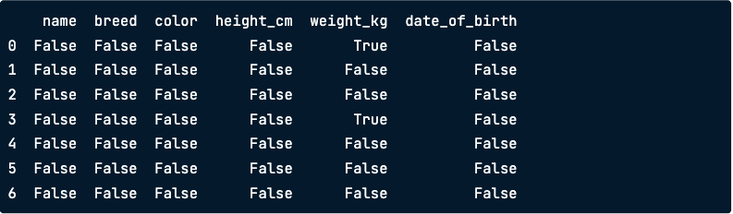
Detecting missing values
dataframe.isna()
Notes:
When you first get a DataFrame, it's a good idea to get a sense of whether it contains any missing values, and if so, how many. That's where the isna method comes in. When we call isna on a DataFrame, we get a Boolean for every single value indicating whether the value is missing or not, but this isn't very helpful when you're working with a lot of data.

Slide 88
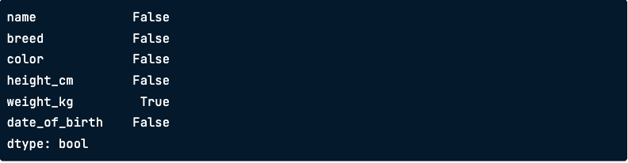
Detecting any missing values
dataframe.isna().any()
Notes:
If we chain dot-isna with dot-any, we get one value for each variable that tells us if there are any missing values in that column. Here, we see that there's at least one missing value in the weight column, but not in any of the others.

Slide 89
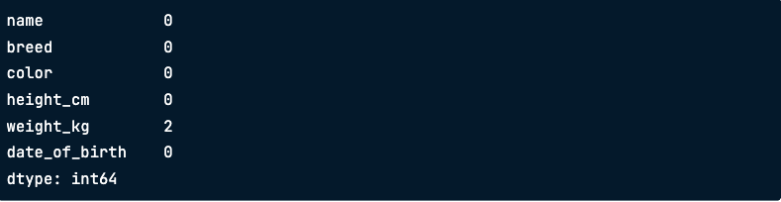
Counting missing values
dataframe.isna().sum()
Notes:
Since taking the sum of Booleans is the same thing as counting the number of Trues, we can combine sum with isna to count the number of NaNs in each column.

Slide 90
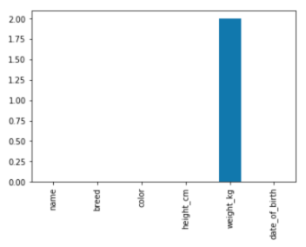
Plotting missing values
import matplotlib.pyplot as plt
dataframe.isna().sum().plot(kind="bar")
plt.show()
Notes:
We can use those counts to visualize the missing values in the dataset using a bar plot. Plots like this are more interesting when you have missing data across different variables, while here, only weights are missing. Now that we know there are missing values in the dataset, what can we do about them?

Slide 91
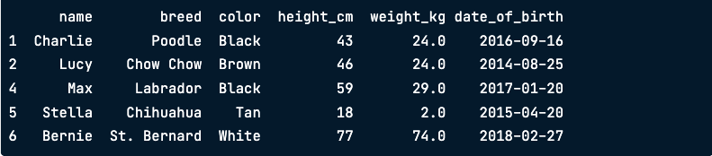
Removing missing values
dataframe.dropna()
Notes:
One option is to remove the rows in the DataFrame that contain missing values. This can be done using the dropna method. However, this may not be ideal if you have a lot of missing data, since that means losing a lot of observations.

Slide 92
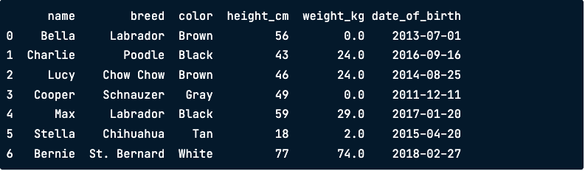
Replacing missing values
dataframe.fillna(0)
Notes:
Another option is to replace missing values with another value. The fillna method takes in a value, and all NaNs will be replaced with this value. There are also many sophisticated techniques for replacing missing values, which you can learn more about in our course about missing data.

Slide 93
Creating DataFrames
Notes:
Now that you've learned a lot about how to work with pandas DataFrames, how do you get data into a DataFrame in the first place?

Slide 94
Dictionaries
my_dict = {
"key1": value1,
"key2": value2,
"key3": value3
}
my_dict = {
"title": "Charlotte's Web",
"author": "E.B. White",
"published": 1952
}
my_dict[key1"]
my_dict["title"]
value1
Charlotte's Web
Notes:
Before creating your own DataFrames, let's talk about dictionaries. A dictionary is a way of storing data in Python. It holds a set of key-value pairs. You can create a dictionary like this, using curly braces. Inside, each key-value pair is written as "key colon value." Let's create a dictionary that holds information about a book. "Title" is a key in the dictionary, and "Charlotte's Web" is its corresponding value, and so on. You can access values of a dictionary via their keys in square brackets. For example, we can access the value of "title" like this

Slide 95

Creating DataFrames
From a list of dictionaries
Constructed row by row
From a dictionary of list
Constructed column by column
Notes:
There are many ways to create DataFrames from scratch, but we'll discuss two ways: from a list of dictionaries and from a dictionary of lists. In the first method, the DataFrame is built up row by row, while in the second method, the DataFrame is built up column by column.

Slide 96
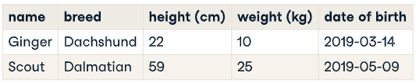
List of dictionaries – by row
list_of_dicts = [
{"name": "Ginger", "breed": "Dachshund", "height_cm": 22,"weight_kg": 10,
"date_of_birth": "2019-03-14"},
{"name": "Scout", "breed": "Dalmatian", "height_cm": 59, "weight_kg": 25,
"date_of_birth": "2019-05-09"}
]
Notes:
We have some new dog data to put into a DataFrame. Let's start with the first method to do this, creating a list of dictionaries. First, we'll create a new list using square brackets to hold our dictionaries. Then, we'll go through the first row of our data and put it in a dictionary. Each key, on the left of each colon, will become a column name. Each value is one dog's data for that column. Here, the first key is "name," which is the first column name, and its corresponding value is "Ginger," the name of the first dog. The second key is the second column name, "breed," and its value is "Dachshund," which is the first dog's breed. Then we have the dog's height and weight. For the next row, we create another dictionary that follows the same format.

Slide 97

List of dictionaries – by row
new_dataframe = pd.DataFrame(list_of_dicts)
print(new_dataframe)
Notes:
Now that we have our list of dictionaries, we can pass it into pd-dot-DataFrame to convert it into DataFrame form.

Slide 98
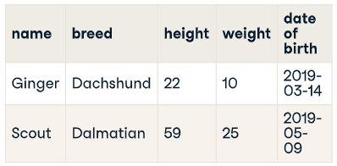
List of lists – by columns
dict_of_lists = {
"name": ["Ginger", "Scout"],
"breed": ["Dachshund", "Dalmatian"],
"height_cm": [22, 59],
"weight_kg": [10, 25],
"date_of_birth": ["2019-03-14", "2019-05-09"]
}
new_dataframe = pd.DataFrame(dict_of_lists)
Key = column name
Value = list of column values
Notes:
Now let's talk about the dictionary of lists method. When using this method, we need to go through the data column by column. Remember that keys are to the left of a colon, and values are to the right. Each key will be a column name, and each value will be a list of the values in the column. First, we'll create a dictionary using curly braces. Let's start with the first column, which is called "name," so the first key is "name." The value is a list containing each name, from top to bottom. In this case, it's "Ginger" and "Scout." Next, we have the "breed" column, so we add "breed" as a key, and its corresponding value is a list containing "Dachshund" and "Dalmatian." Then we have height_cm, which is 22 and 59, and weight_kg, which is 10 and 25. Now that we have our dictionary of lists set up, we can pass it into pd-dot-DataFrame to convert it into a pandas DataFrame.

Slide 99

List of lists – by columns
print(new_dataframe)
Notes:
If we print the new DataFrame, we can see that it's exactly what we wanted.

Slide 100
Reading and Writing CSVs
Notes:
You now know how to create your own DataFrames, but typing out your data entry-by-entry isn't usually the most efficient way to get your data into a DataFrame. In this video, you'll learn how to pull data from CSV files.

Slide 101
What’s CSV file
CSV = comma-seperated values
Designed of DataFrame-like data
Most Database and spreadsheet programs can use them or create them
Notes:
CSV, or comma-separated values, is a common data storage file type. It's designed to store tabular data, just like a pandas DataFrame. It's a text file, where each row of data has its own line, and each value is separated by a comma. Almost every database, programming language, and piece of data analysis software can read and write CSV files. That makes it a good storage format if you need to share your data with other people who may be using different tools than you.

Slide 102
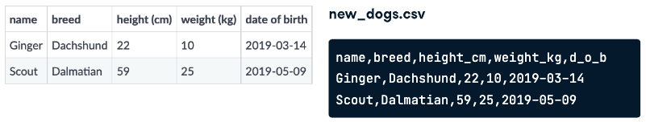
Example CSV File
Notes:
Remember the dogs from the last video? Their data is stored in a CSV file called new_dogs-dot-csv, which looks like this.

Slide 103

CSV to DataFrame
import pandas as pd
new_dataframe = pd.read_csv(“your csv file”)
print(dnew_ataframe)
Notes:
We can put this data in a DataFrame using the handy pandas function, read-underscore-csv, and pass it the file path of the CSV.

Slide 104

DataFrame manipulation
new_dataframe["bmi"] = new_dataframe["weight_kg"] / (new_dataframe["height_cm"] / 100) ** 2
print(new_dataframe)
Notes:
Now that the data is in DataFrame form, we can manipulate it using some of the functions from earlier in the course. Here, we'll add a body mass index column.

Slide 105

DataFrame to CSV
new_dataset.to_csv("new_dataset_with_bmi.csv")
Notes:
Now that we've changed the data let's create an updated CSV file to share with the dogs' owners. To convert a DataFrame to a CSV, we can use new_dogs dot to-underscore-csv, and pass in a new file path. If we take a look at the new file, it contains the BMI column.

Slide 106
Pre & Post Test
1. How to open csv file using pandas?
pd.read_csv(“file.csv”)
pd.open_csv(“file.csv”)
pd.to_csv(“file.csv”)
pd.view_csv(“file.csv”)
2. How to display row with column “Major” that contain ”Data Science”?
dataframe[dataframe[“Major”]] == “Data Science”
dataframe[“Major”] == “Data Science”
dataframe[“Major”] = “Data Science”
”Major” == “Data Science”
3. How to filter dataframe with GPA > 3.5?
dataframe[“GPA”] > 3.5
dataframe[dataframe[“GPA”]] > 3.5
dataframe[dataframe[“GPA”]] > “3.5”
dataframe[“GPA”] > “3.5”

Slide 107
Pre & Post Test
4. if GPA >= 3.5. Students get cumlaude predicate. How we can add ”Cumlaude” column?
dataframe[dataframe[“Cumlaude”]] = dataframe[“GPA”] >= 3.5
dataframe[“Cumlaude”] = dataframe[“GPA”] >= 3.5
(dataframe[“GPA”] >= 3.5).to_column(dataframe[“Cumlaude”])
dataframe[“cumlaude”].addColumn(dataframe[“GPA”] >= 3.5)
5. If we have csv file and we want to save csv file using pandas python. How to make it?
pd.write(“filename.csv”)
pd.open(“filename.csv”)
open(“filename.csv”)
pd.to_csv(“filename.csv”)
6. How we can dropping duplicate names in DataFrames?
del dataframe[“name"] if name.duplicate
drop.dataframe[name]
dataframe.drop_duplicates(subset=“name”)
dataframe[“name”].drop_duplicate

Slide 108
Pre & Post Test
7. How to grouping students who take courses with mean value?
dataframe.groupby([“Course”]).mean
Dataframe[“name”][“Course”].mean()
Dataframe.groupby[“name][“Course”].mean
dataframe.groupby(“name”)[“Course”].mean()
8. If we have list of variable with name is “Student” and the length is 100. How we can access 10 lists from the end?
Student[10:]
Student[len(Student)]
Student[:10]
Student[10]
9. We can display statistical like count, mean, std, min, max with pandas function?
statistic()
dtatistical()
describe()
Info()

Slide 109
Pre & Post Test
10. How to sorting values dataframe?
Using sort_values()
Using sorted()
Using sort_list()
Using sort_row()

Slide 110
Exam/Assessment/Assignment
What percent of sales occurred at each store type?
While .groupby() is useful, you can calculate grouped summary statistics without it.
Walmart distinguishes three types of stores: "supercenters," "discount stores," and "neighborhood markets," encoded in this dataset as type "A," "B," and "C." In this exercise, you'll calculate the total sales made at each store type, without using .groupby(). You can then use these numbers to see what proportion of Walmart's total sales were made at each type.
sales is available and pandas is imported as pd.

Slide 111
INSTRUCTIONS
Calculate the total weekly_sales over the whole dataset.
Subset for type "A" stores, and calculate their total weekly sales.
Do the same for type "B" and type "C" stores.
Combine the A/B/C results into a list, and divide by sales_all to get the proportion of sales by type.

Slide 112
Exam/Assessment/Assignment
# Calc total weekly sales
sales_all = ____["____"].____()
# Subset for type A stores, calc total weekly sales
sales_A = ____[____["____"] == "____"]["____"].____()
# Subset for type B stores, calc total weekly sales
sales_B = ____
# Subset for type C stores, calc total weekly sales
sales_C = ____
# Get proportion for each type
sales_propn_by_type = [sales_A, ____, ____] / ____
print(sales_propn_by_type)

Slide 113
Answer
# Calc total weekly sales
sales_all = sales["weekly_sales"].sum()
# Subset for type A stores, calc total weekly sales
sales_A = sales[sales["type"] == "A"]["weekly_sales"].sum()
# Subset for type B stores, calc total weekly sales
sales_B = sales[sales["type"] == "B"]["weekly_sales"].sum()
# Subset for type C stores, calc total weekly sales
sales_C = sales[sales["type"] == "C"]["weekly_sales"].sum()
# Get proportion for each type
sales_propn_by_type = [sales_A, sales_B, sales_C] / sales_all
print(sales_propn_by_type)

Slide 114
TEACHING NOTES*
Lesson/Topics
Case Study
Clips
Games
Others : . . . . . . . . . . . .
OBJECTIVES
PERSIAPAN
Mampu melakukan manipulasi terhadap data di pandas python
Offline: Ruangan
Online: Menyiapkan link zoom
OVERVIEW
DIRECTION
Pada modul ini, user akan mendapatkan penjelasan mengenai cara visualisasi data menggunakan library seaborn dengan hue, di modul ini juga terdapat bagaimana cara customize plot agar visualisasi dapat terbaca dengan baik
Menjelaskan apa, bagaimana dan tujuan dari kegiatan;
Mengatur dan mengelola arah dan jalannya diskusi;
Memberikan contoh-contoh, kasus dan ilustrasi;
Memberikan apresiasi dalam tanya jawab;
Memberikan debrief atau insight/pesan dari kegiatan;
Memberikan dan menyampaikan kesimpulan dan di tiap sesi atau di akhir sesi.
PERALATAN YANG DIBUTUHKAN
Offline:
Proyektor
Online:
Link zoom, laptop
*Catatan : jumlah halaman teaching Note dapat ditambah sesuai kebutuhan

Slide 115
TEACHING NOTES 2/2*
DIRECTION
Section (slide/clip/case/etc) | Activities (Hal apa yang akan dilakukan untuk setiap section-nya) | Description (hal-hal spesifik yang harus dilakukan, misal : penjelasan dan atau penekanan materi, pengelolaan arah dan jalannya diskusi, wrap up/insight atau debrief, etc)
4 sd 5 | Penjelasan overview dan objektif pembelajaran. Presentasi | SME menjelaskan gambaran modul dan objektif dari pembelajaran.
7 sd 19 | Penjelasan gambaran apa itu DataFrames pandas Presentasi Diskusi | SME gambaran apa itu DataFrames pandas
20 sd 32 | Penjelasan melakukan sorting dan subsetting pada pandas Presentasi Diskusi | SME menjelaskan cara melakukan sorting dan subsetting pada pandas
33 sd 35 | Penjelasan cara menambahkan kolom pada dataframe Presentasi Diskusi | SME menjelaskan cara menambahkan kolom pada dataframe
37 sd 41 | Penjelasan tentang summary statitstic pada pandas Presentasi Diskusi | SME menjelaskan tentang summary statitstic pada pandas

Slide 116
TEACHING NOTES 2/2*
DIRECTION
Section (slide/clip/case/etc) | Activities (Hal apa yang akan dilakukan untuk setiap section-nya) | Description (hal-hal spesifik yang harus dilakukan, misal : penjelasan dan atau penekanan materi, pengelolaan arah dan jalannya diskusi, wrap up/insight atau debrief, etc)
43 sd 45 | Penjelasan tentang cara cara melakukan counting pada pandas Presentasi Diskusi | SME menjelaskan cara melakukan counting pada pandas
46 sd 50 | Penjelasan tentang cara melakukan Groupped Summary Statistics Presentasi Diskusi | SME menjelaskan cara melakukan Groupped Summary Statistics
51 sd 55 | Penjelasan tentang cara melakukan Pivot Table Presentasi Diskusi | SME menjelaskan cara melakukan Pivot Table
57 sd 62 | Penjelasan tentang cara melakukan Explicit Index Presentasi Diskusi | SME menjelaskan cara melakukan Explicit Index

Slide 117
TEACHING NOTES 2/2*
DIRECTION
Section (slide/clip/case/etc) | Activities (Hal apa yang akan dilakukan untuk setiap section-nya) | Description (hal-hal spesifik yang harus dilakukan, misal : penjelasan dan atau penekanan materi, pengelolaan arah dan jalannya diskusi, wrap up/insight atau debrief, etc)
63 sd 73 | Penjelasan tentang cara melakukan slicing dan subsetting .loc dan .iloc Presentasi Diskusi | SME menjelaskan cara melakukan slicing dan subsetting .loc dan .iloc
74 sd 78 | Penjelasan tentang cara membuat pivot table with iloc dan loc Presentasi Diskusi | SME menjelaskan cara melakukan pivot table with iloc dan loc
80 sd 92 | Penjelasan tentang cara melakukan visualisasi Presentasi Diskusi | SME menjelaskan cara melakukan visualisasi
93 sd 105 | Penjelasan tentang cara membuat dictionary untuk parameter color pada hue Presentasi Diskusi | SME menjelaskan cara membuat dataframe dan membaca / menyimpan file csv menggunakan pandas
106 sd 113 | Quiz time Presentasi Diskusi Quiz menggunakan animasi | SME memberikan penjelasan pertanyaan dari QUIZ, quiz harus mengcover seluruh isi dari seluruh topik

Slide 118
References/Additional Resources
Slide
https://datacamp.com

